Slide 1
Norway new car sales
STAT 515 Final Project
Yufei，Amit

Slide 2
Introduction
Norway has the highest number of electric cars per capita.
From Recent data of all new car sales, 40.2% are electric cars and hybrid cars.
Norway has become the leading market for electric cars and hybrid cars
Norway has had highest CO2 emission reduction compared to other countries.
Diesel car registration market share has been declining over last decade.
Norway also Imports plenty of electric and hybrid cars.
For an Oil producing and exporting nations, these numbers show a unique trend.

Slide 3
Purpose: Analyze Current and future Car Sale Trends
Understand Trend & Total quantity of new car sales
Trend and Quantity of electric cars & what is driving the recent phenomenon.
Trend and Quantity of hybrid cars
Trend and Quantity of imported electric cars and reasons behind increased sale.
Quantity of import cars and Popularity of different car makes and models.
Trend and Quantity of Diesel cars
Average CO2 emission reduction analysis.

Slide 4

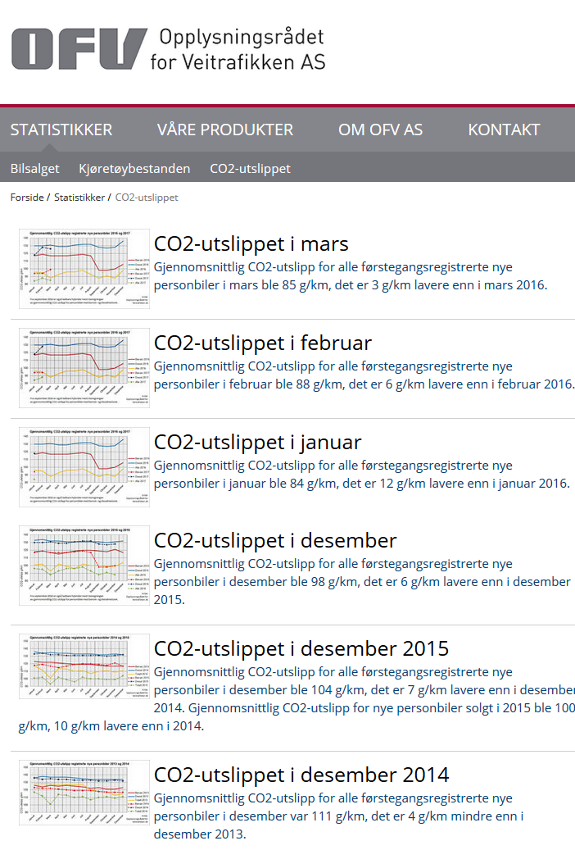

Slide 5
Data preparation, cleaning and back-casting
4 sheets of data :
Norway Cars Sale by Model,
Norway Cars Sale by Make,
Norway Cars Sale by Month,
Norway Oil Production.
Removed Norway Oil data after analyzing scatterplot and correlation outcomes.
Replaced NA’s in original data by using Back-casting methods that recognizes patterns over 12 month period in future (similar to moving averages).
Newly generated data retained the pattern of available data in order to be used for final analysis.
Utilized Excel and R-Studio to finalize the data.

Slide 6
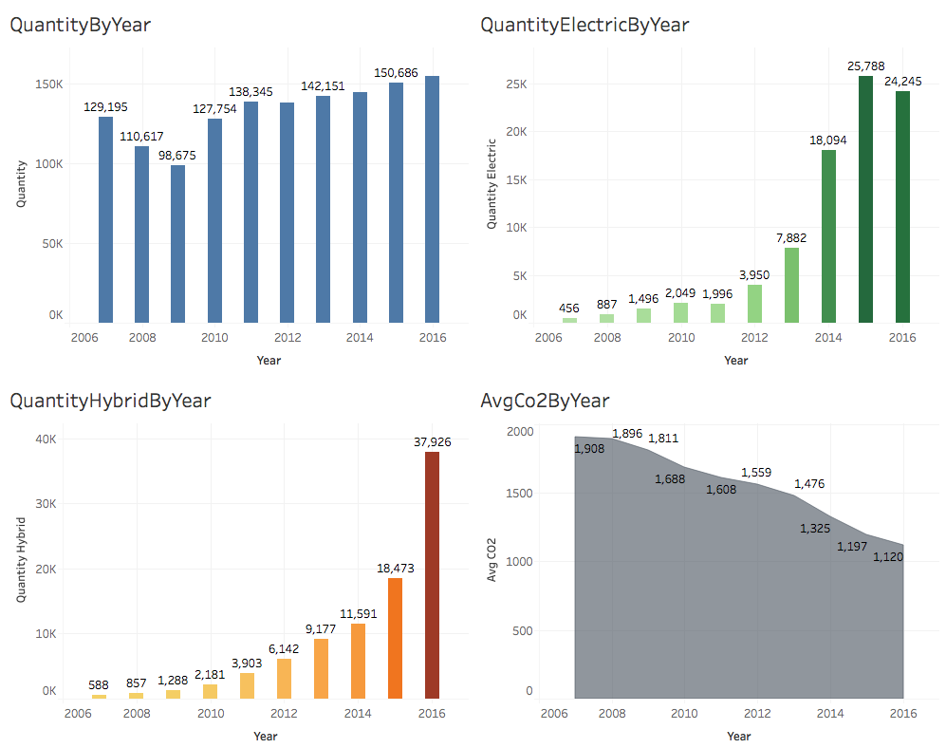
Visualization and Exploration

Slide 7
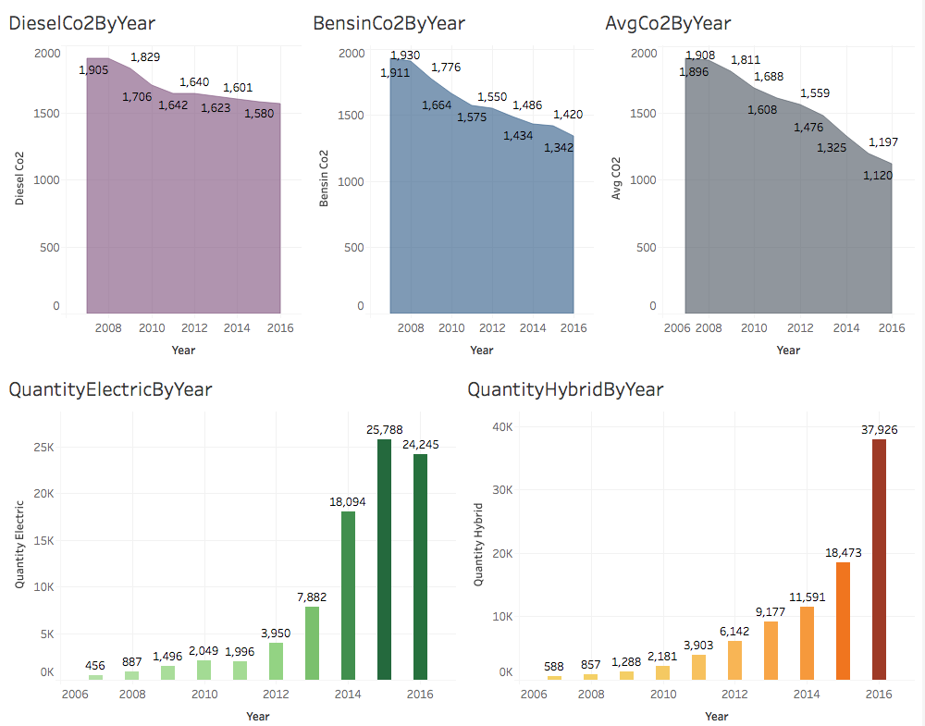
Visualization and Exploration

Slide 8
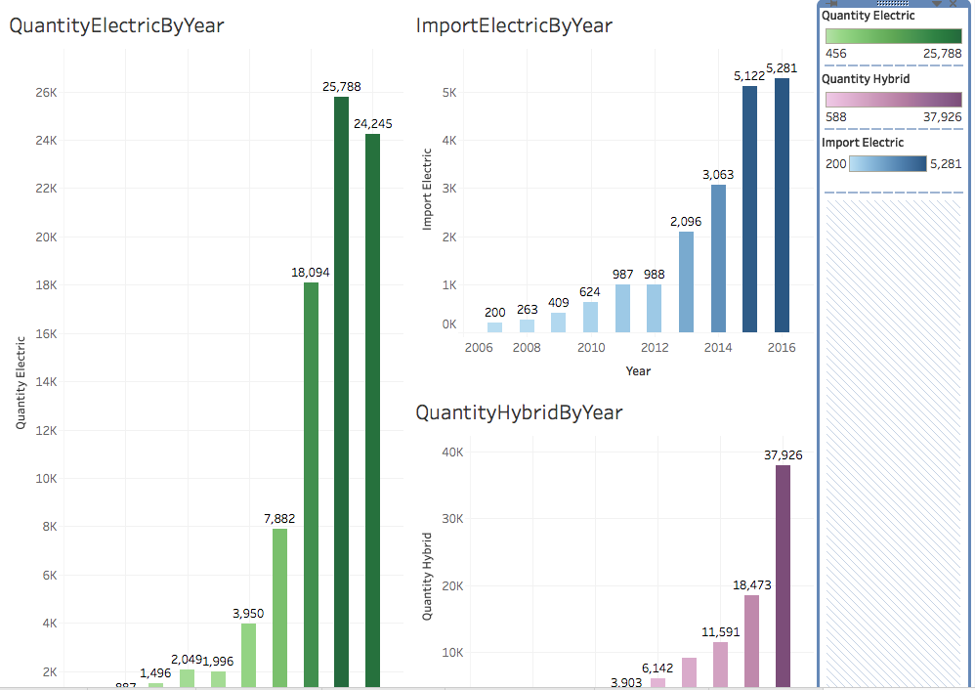
Visualization and Exploration

Slide 9
Linear Regression model
Quantity ~ 1.000e+04+7.475e-02*Import +017.247e+01*Avg_CO2 -2.500e+01*Bensin_Co2 - 4.294e+01*Diesel_Co2 + 1.420e*Quantity_Diesel + -1.569e+02*Diesel_Share + 5.117e-01*Quantity_Hybrid + 9.261e-01*Quantity_Electric -6.892e-02*Import_Electric
Forward model:
R-square: 0.9968259
MSE: 5494.265
Backward model:
R-square: 0.9965927
MSE: 6865.47

Slide 10
linear regression models Analyzed
Quantity_Electric ~ Quantity + Import + Avg_CO2 + Bensin_Co2 + Diesel_Co2 + Quantity_Diesel + Diesel_Share + Quantity_Hybrid + Import_Electric
Import_Electric ~ Quantity + Import + Avg_CO2 + Bensin_Co2 + Diesel_Co2 + Quantity_Diesel + Diesel_Share + Quantity_Hybrid + Quantity_Electric
Quantity_Hybrid ~ Quantity + Import + Avg_CO2 + Bensin_Co2 + Diesel_Co2 + Quantity_Diesel + Diesel_Share + Quantity_Electric + Import_Electric
Import ~ Quantity + Avg_CO2 + Bensin_Co2 + Diesel_Co2 + Quantity_Diesel + Diesel_Share + Quantity_Hybrid + Quantity_Electric + Import_Electric
Quantity_Diesel ~ Quantity + Import + Avg_CO2 + Bensin_Co2 + Diesel_Co2 + Diesel_Share + Quantity_Hybrid + Quantity_Electric + Import_Electric
Avg_CO2 ~ Quantity + Import + Quantity_Electric + Bensin_Co2 + Diesel_Co2 + Quantity_Diesel + Diesel_Share + Quantity_Hybrid + Import_Electric
Quantity_Hybrid + Quantity_Electric + Import_Electric ~ Import + Avg_CO2 + Bensin_Co2 + Diesel_Co2 + Quantity_Diesel + Diesel_Share +Quantity

Slide 11
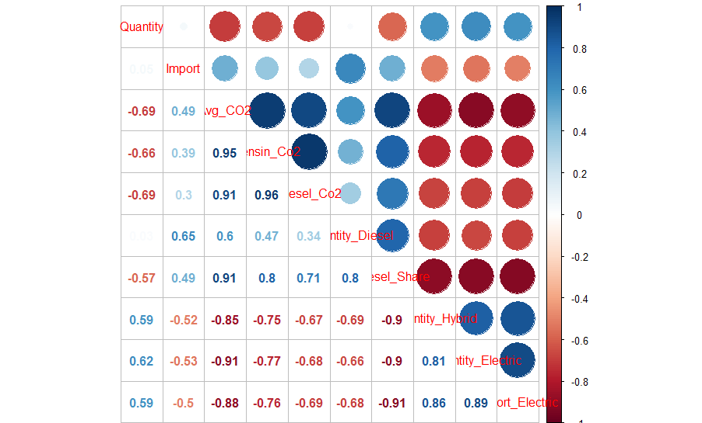
Correlations of available data for analysis

Slide 12
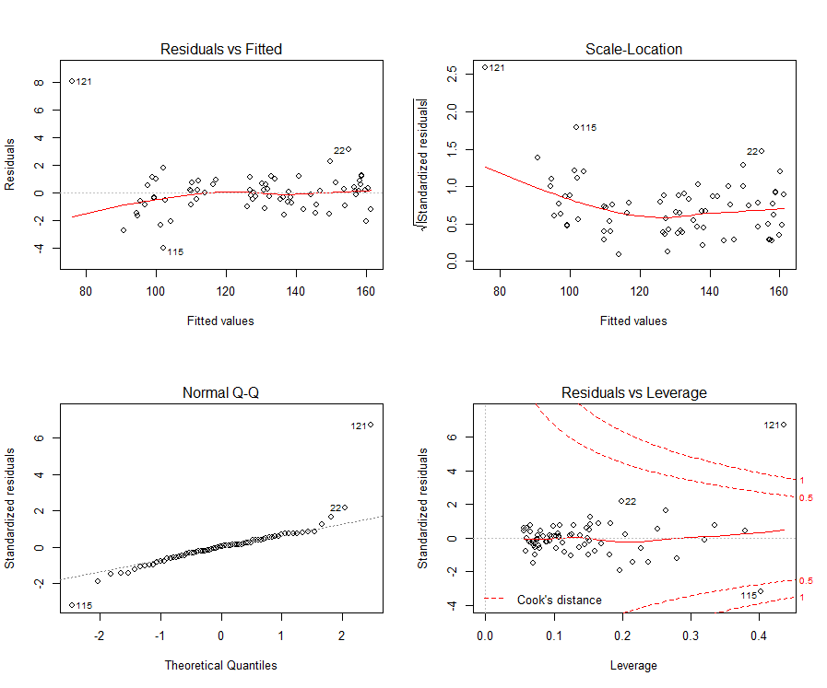
Multiple Linear regression methods for Green Cars
Predicting Green Cars with Full Regression: predict(trainfit,data.frame(Quantity=13500,Quantity_Diesel=3433,Diesel_Share=26,Diesel_Share_LY=38,Import = 1550,Used =36078,Avg_CO2=84,Bensin_Co2=94,Diesel_Co2=118),interval='confidence')
fit lwr upr
1 6094.05 5699.559 6488.542 ➔ Actual: 7208.
>predict(AVGCO2FULL,data.frame(Quantity=13055,Import = 1550,Used = 36078,Quantity_Diesel=3433,Diesel_Share=26,Diesel_Share_LY=38, Quantity_Electric=2295,Quantity_Hybrid=4419,Import_Electric=494,Bensin_Co2=94,Diesel_Co2=118),interval='confidence')
fit lwr upr
1 75.6433 73.46871 77.8179 ➔ Actual : 84

Slide 13
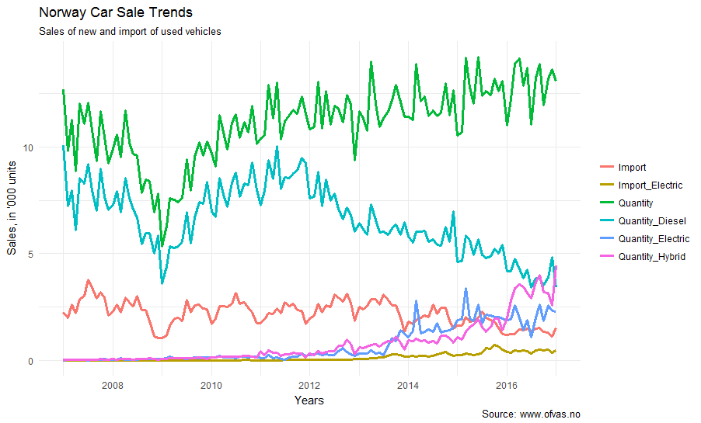
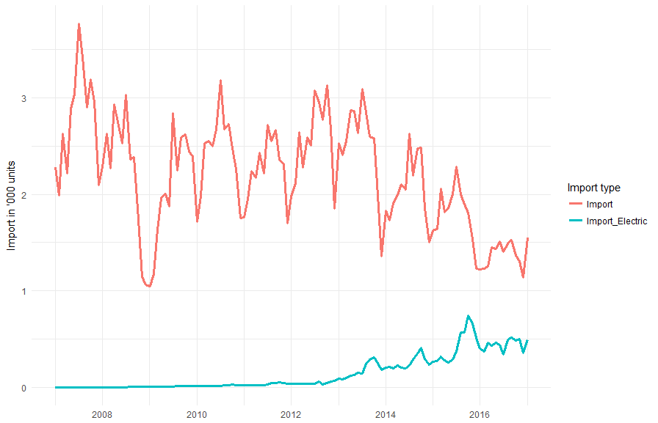
Trends of Import and Import Electric Vehicles, with back-casting.

Slide 14
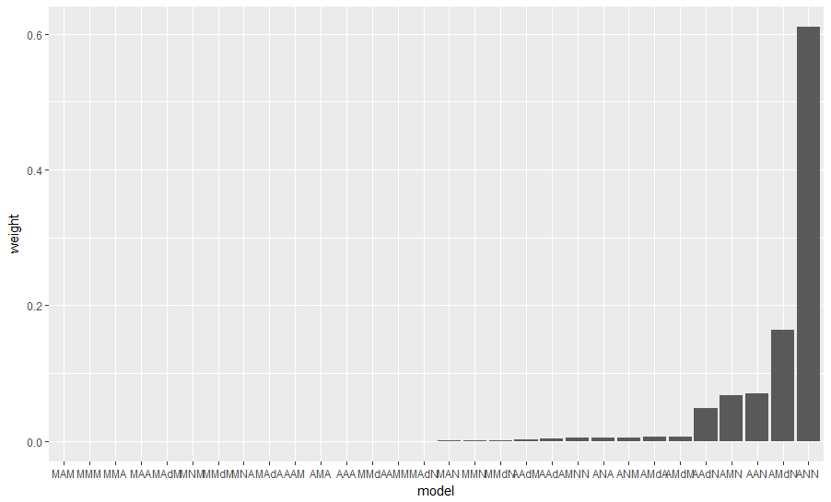
Comparisons of various exponential smoothing models

Slide 15
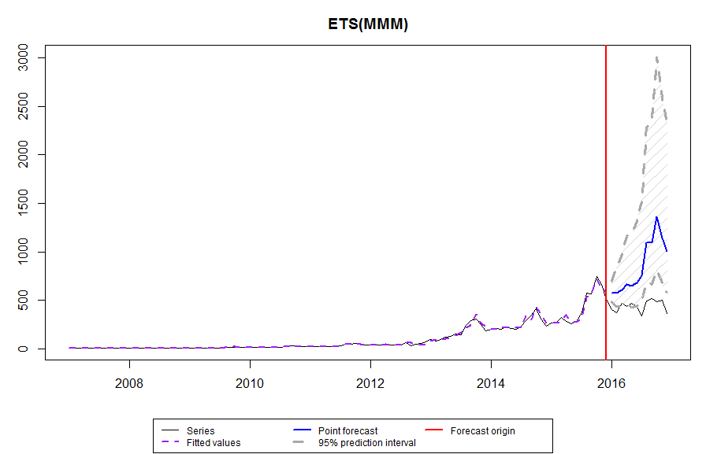
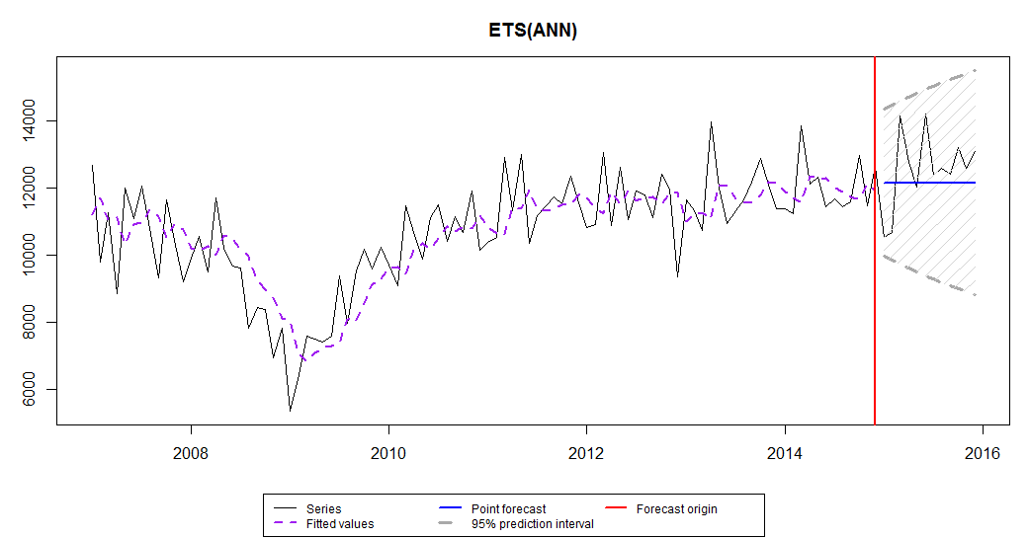
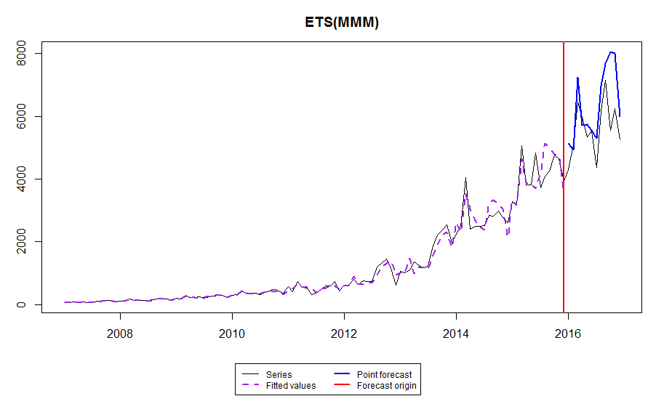
Import Electric and Green Car Trends
Exponential Time Series of Total Vehicle Quantity over last decade.

Slide 16
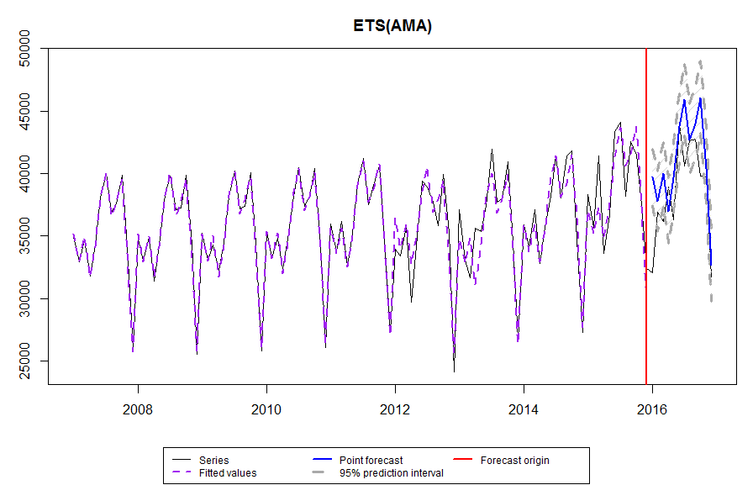
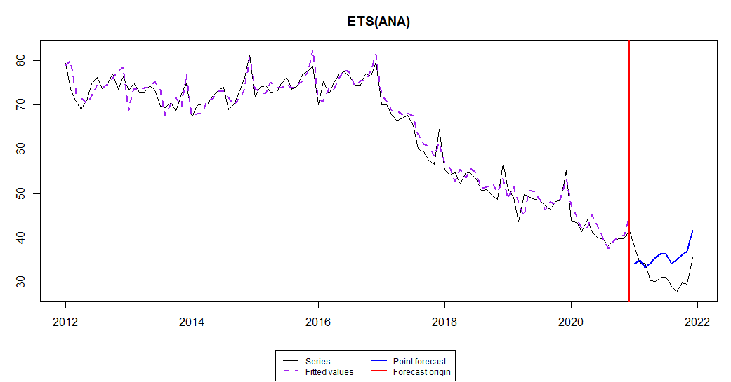
Diesel FORECAST, Used Vehicle Back & Forecast
Filled in pre-2011 data for Used cars with back-casting techniques that can retain patterns over the months.
Exponential Time Series shows a trend that there might be a slight increase in the Used car registration due to obvious reasons.
Another Exponential Time Series on Diesel car sales based on market share indicates that diesel car sales has been declining and will continue the trend in upcoming years.

Slide 17
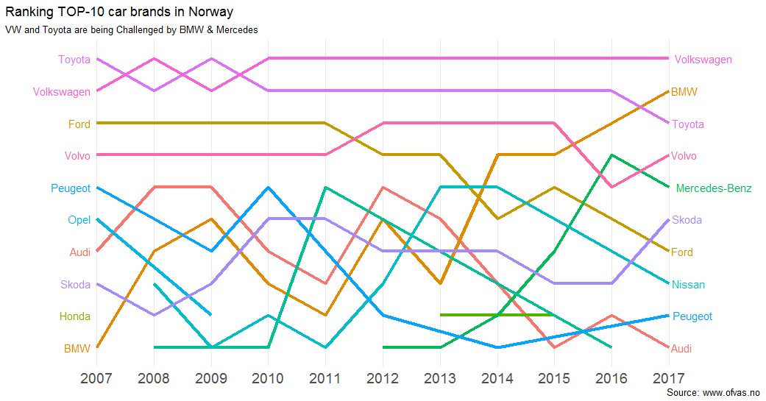
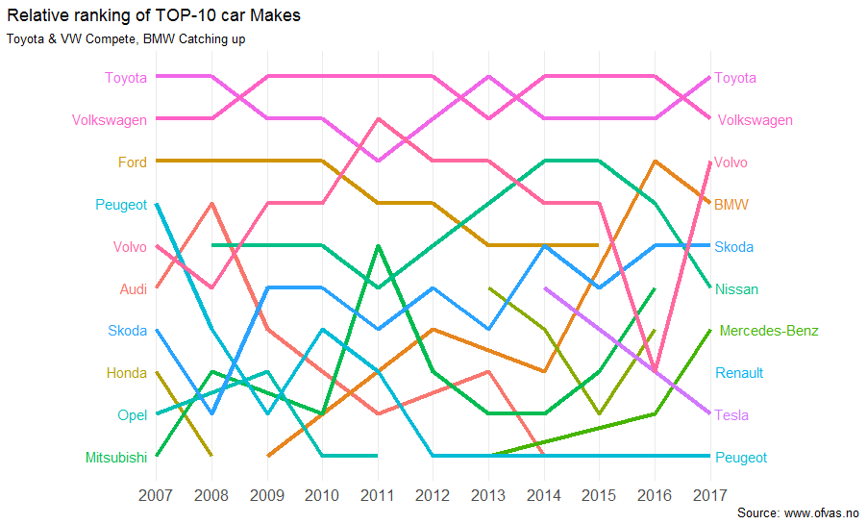
Comparing outcomes of two different data sheets

Slide 18
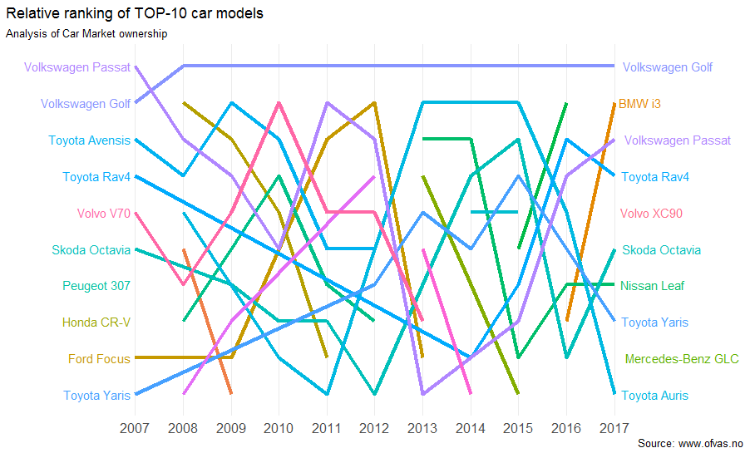
Trend of top-10 car Models
Volkswagen Golf is the most popular car model in Norway.
3 Toyota cars have been popular in Last decade – however, the popular models have changed.
Skoda Octavia has had consistent sales and have maintained position in top ten through out the years.
Volkswagen Passat was the most popular model that has seen ups and downs over the decade.
BMW i3 has come up to become a competitor to Volkswagen Golf just in a year.

